Slide 1
Python Unittest Framework
Venkata Shyam Kumar M

Slide 2
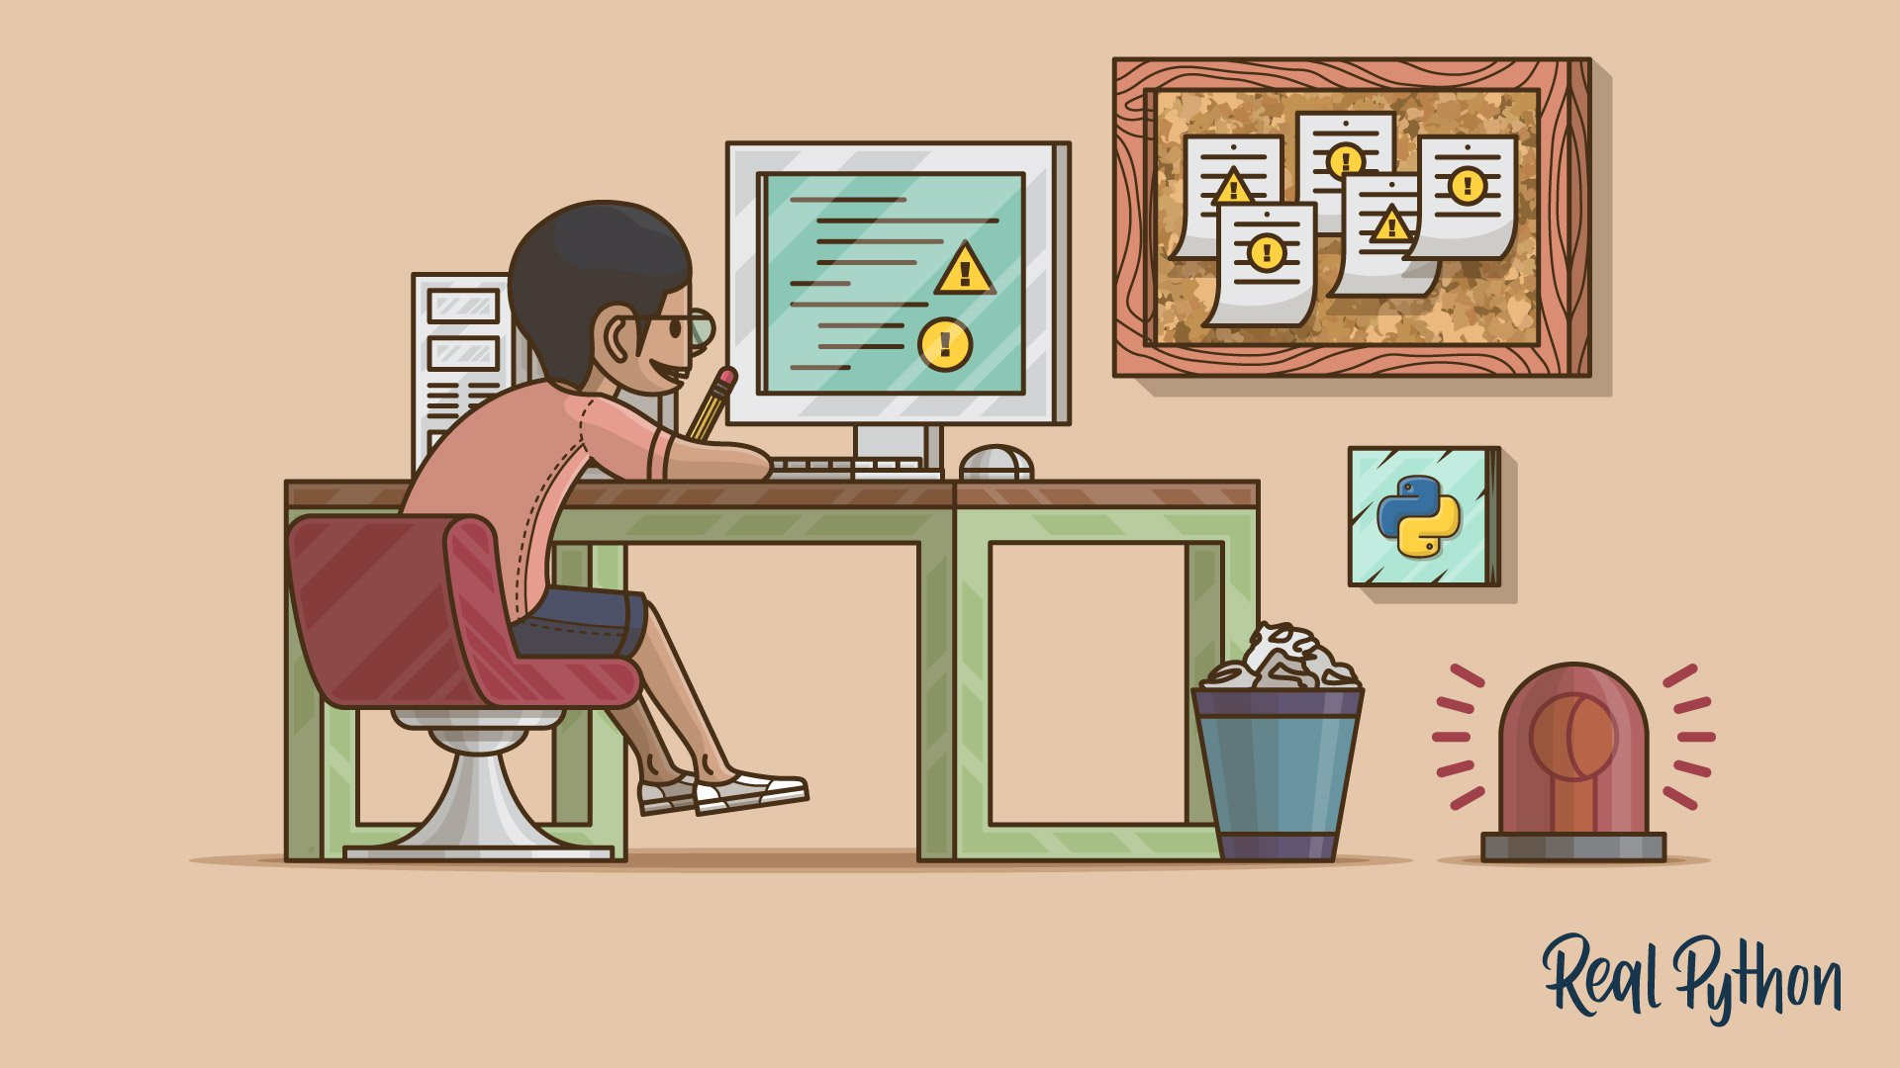
Agenda
Framework overview
What is a framework?
Types
Unit test Framework
Demo
Practical/ Assignments

Slide 3
What is a Framework?
Framework can be defined as a set of guidelines which when followed produce beneficial results.
TEST Automation Framework
A set of guidelines like coding standards , test-data handling , object repository treatment etc... which when followed during automation scripting produce beneficial outcomes like -
increase code re-usage ,
higher portability ,
reduced script maintenance cost etc.
These are just guidelines and not rules;
They are not mandatory and you can still script without following the guidelines.
But you will miss out on the advantages of having a Framework.
Arrays of object references

Slide 4
Types of Automation Framework
,
1) Linear Scripting (Record and Playback) 2) The Test Library Architecture F/W. 3) The Data-Driven Testing F/W. 4) The Keyword-Driven or Table-Driven F/W. 5) The Hybrid Test Automation F/W.
Arrays of object references
4

Slide 5
Unittest framework
Unit testing is a software testing method by which individual units of source code, such as functions, methods, and class are tested to determine whether they are fit for use.
Reffered as “PyUnit”
Python language version of JUnit
Part of the Python Standard Library as of Python version 2.1
Advantages of using Python Unit testing
It helps you to detect bugs early in the development cycle
It helps you to write better programs
It syncs easily with other testing methods and tools
It will have many fewer bugs
It is easier to modify in future with very less consequence

Slide 6
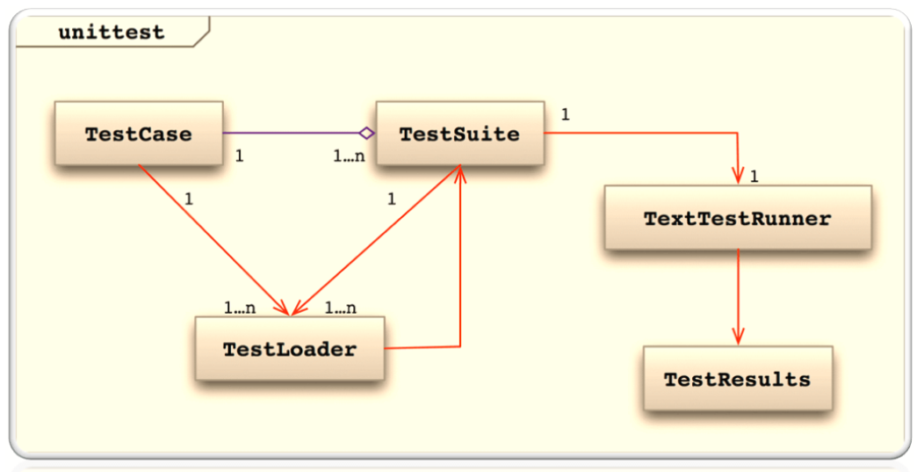
Unittest Classes

Slide 7
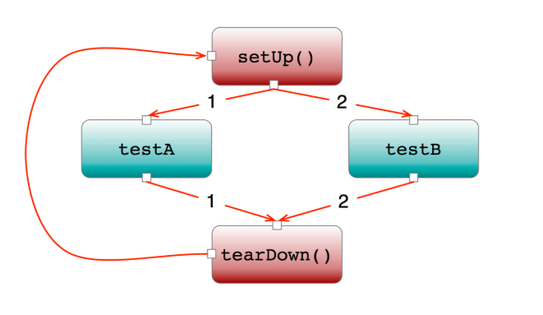
Unittest TestCase Class Flow
setUpClass()
tearDownClass()

Slide 8
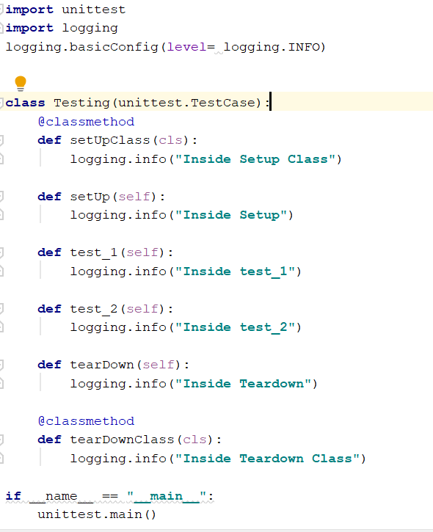
Unittest Scripting

Slide 9
DEMO
Selenium using Unittest
REST API using Unittest

Slide 10
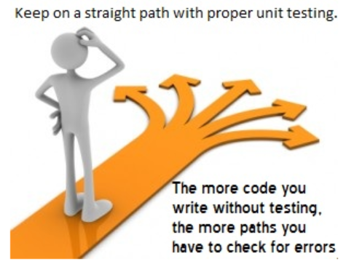
Practical/ Assignments

Slide 11
ASSIGNMENTS
[GROUP1] Write a Test case to create a Group in Groups and Configs section using Selenium and REST API
[GROUP2] Write a Test case to create a group admin user that already exists using Selenium and REST API
[GROUP3] Write a Test case to create a global admin user using Selenium and REST API
[GROUP4] Write a Test case to delete a created group admin user (Deactivate and than Delete)

Slide 12
Thank you

